Slide 1



Challenge #21
Analysing the trend of Foreign Philanthropy in India

Slide 2
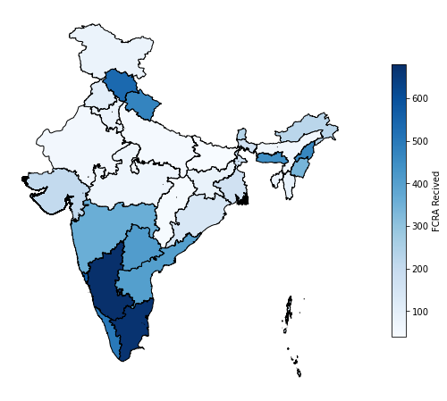
Geographic Distribution of FCRA Funds
(2016-2019)
6 Southern States accounts for 68.72% of the FCRA funds.
Some North-eastern states are receiving relatively higher amounts of FCRA.

Slide 3
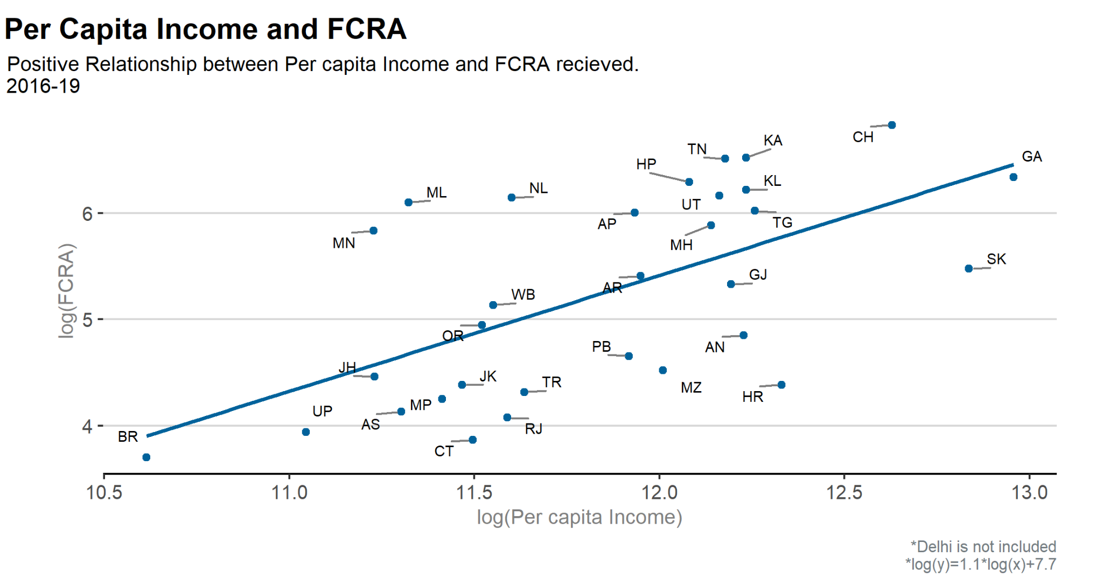

Slide 4
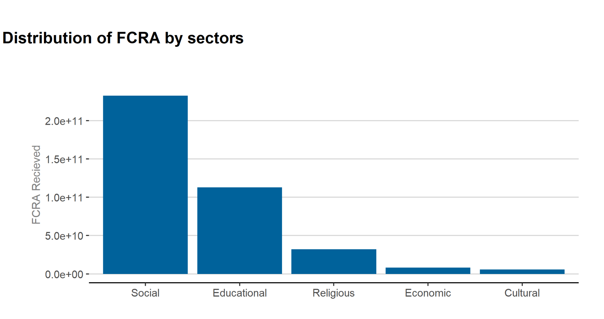

Slide 5
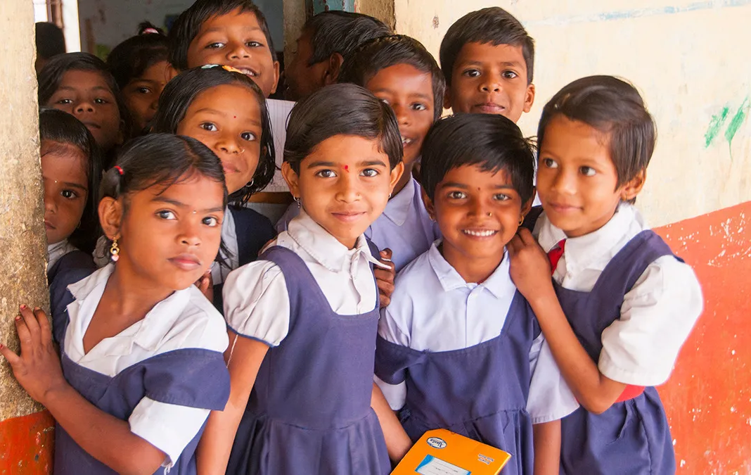
Education sector
trends
MOTIVATION
Important sector in Indian context
Understanding why states get what they get
Image source: GiveIndia

Slide 6
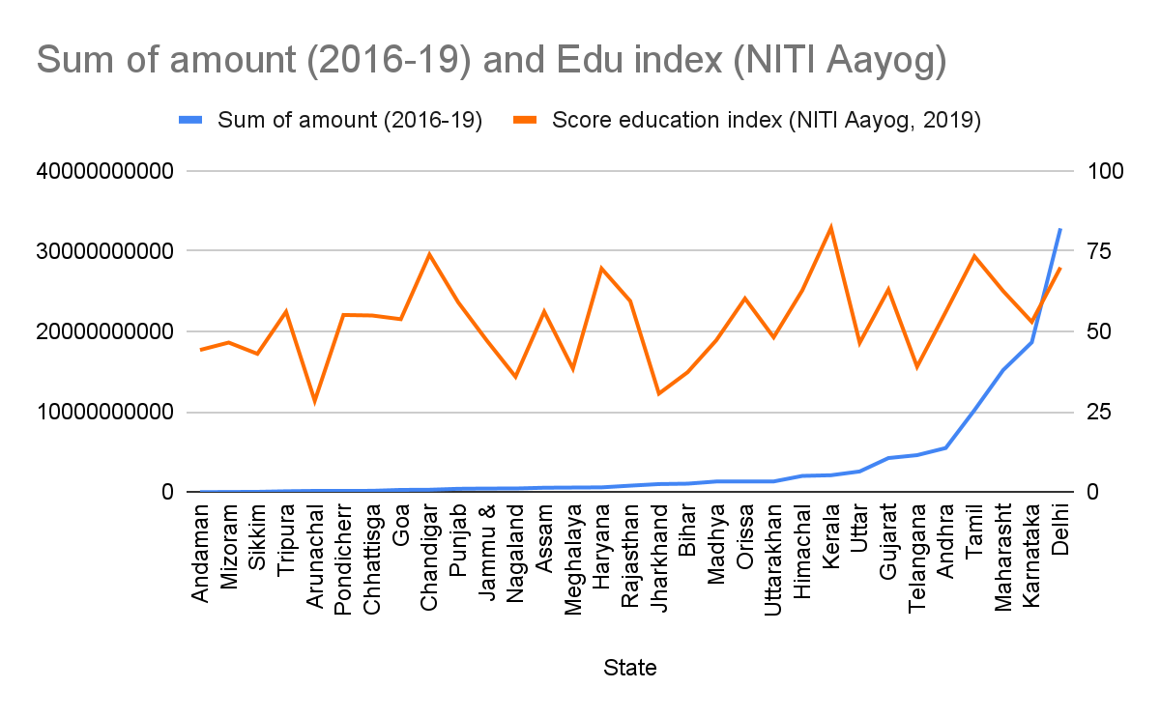
Education sector trends
METHOD
Collecting data
Merging
Analyzing
correlation: 0.32

Slide 7
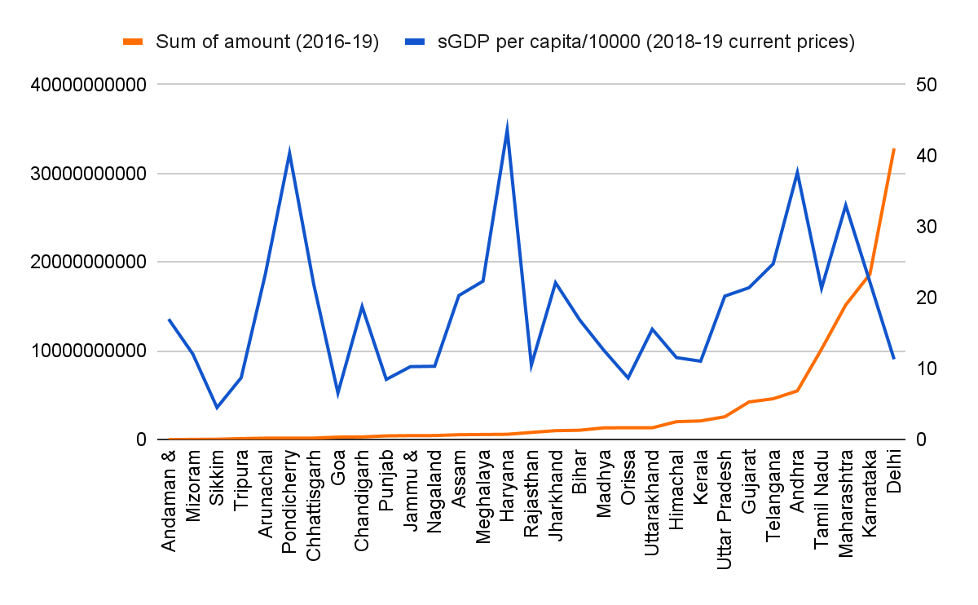
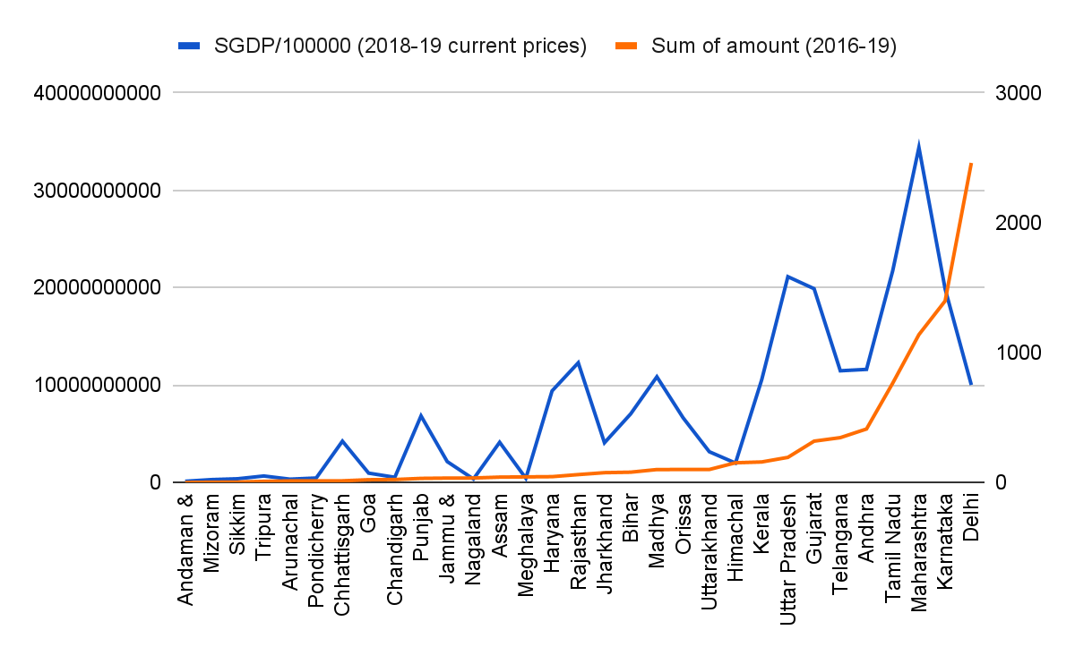
Education sector trends
correlation: 0.094
correlation: 0.54
without Delhi: 0.79
INFERENCE
Depends on states’ economic conditions
Delhi effect

Slide 8
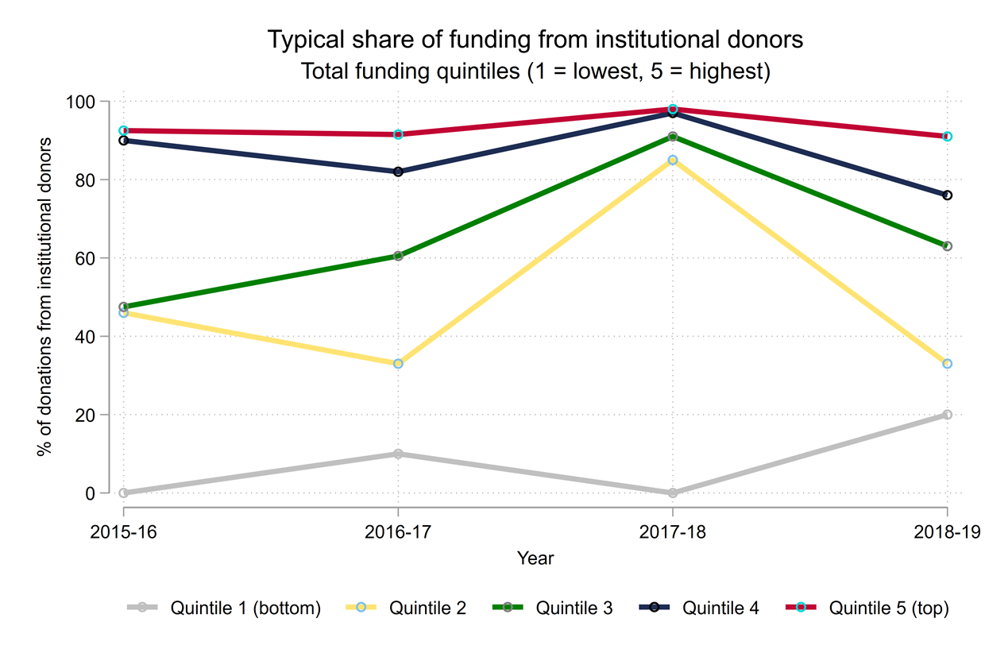






Share of funding from institutional donors
Countries divided into quintiles
Quintile 1: Lowest
Quintile 5: Highest
Institutional donors vs Individual donors
Higher variation in lower quintiles
Notes:
This visualisation shows the share of a country’s funding that is provided by institutional donors. We divide countries into quintiles by total amount of funding: The US, UK, Netherlands are three countries that typically provide the highest amount of funding to Indian nonprofits and therefore are found in quintile 5; Afghanistan, Bolivia and Madagascar typically provide some of lowest levels of funding and therefore are found in quintile 1.
The differences between quintiles are unsurprising: institutional donors will be able to provide more funding than individuals.
There is considerably more variability in the lower quintiles: in some years the typical share of funding from institutional donors is 0; in others it is as high as 20%.

Slide 9
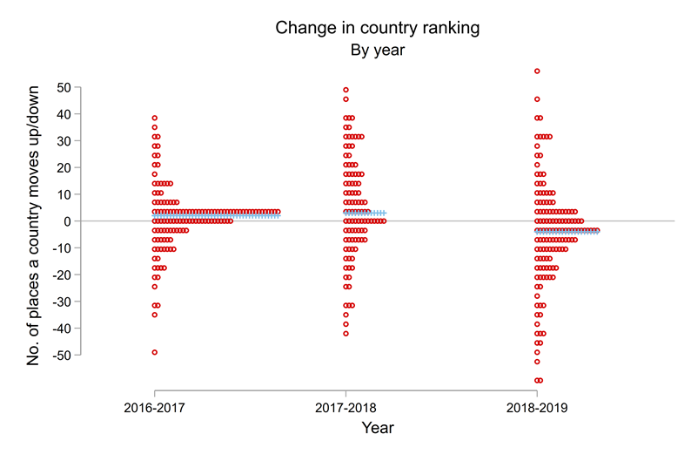
Change in ranking of country
Notes:
This visualisation shows the distribution of changes in the ranking of a country. We can rank countries by how much funding they provide to Indian nonprofits: the US tends to top this ranking, while Senegal and Iraq tend to appear at the bottom of the rankings. We then look at changes in a country’s ranking over time: for example, in 2015-16 Bosnia was ranked 77th in terms of the total funding it provided, while in 2016-17 it was ranked 125th. Data points above the horizontal line represent countries who achieved a higher ranking than the previous year, countries below the line represent countries who achieved a lower ranking.
On average countries retain their ranking over time i.e., maintain their relative importance to Indian nonprofits, though small changes in ranking are common as well.

